Slide 1
Deep Reinforcement Learning for Programming Language Correction
Rahul Gupta, Aditya Kanade, Shirish Shevade Department of Computer Science and Automation Indian Institute of Science Bangalore, KA 560012, India
{rahulg, kanade, shirish}@iisc.ac.in
刘芳
2018/7/4

Slide 2
01
Introduction
02
Framework
CONTENTS
03
Model
04
Experiments

Slide 3
01
Introduction

Slide 4
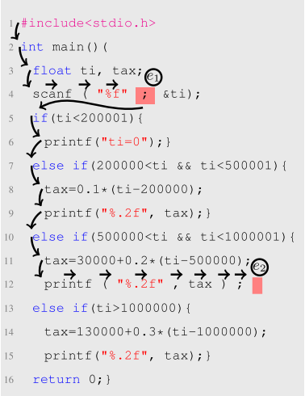
01
Introduction
Automatically correcting common syntactic errors in programs
When faced with an error, a programmer navigates through the program text to arrive at the location of error and then performs an edit to fix the error.
While the agent can access and modify the program text, the compiler which checks syntactic validity of the program text is a black-box for the agent.
The goal of the agent is to perform edits necessary for successful compilation of the program

Slide 5
02
Framework

Slide 6
02
Framework
A programming language (PL) correction framework in which an agent can mimic these actions.
States
<string, cursor> where string is the program text, and cursor ∈ {1, . . . , len(string)}.
Encode the state into a sequence of tokens :
Convert the program string into a sequence of lexemes (such as keywords, operators, types, functions, literals, and variables. In addition, we also retain line-breaks as lexemes to allow two-dimensional navigation actions over the program text.
The cursor part of the state is represented by a special token, which is inserted in the sequence of lexemes right after the token whose index is held by cursor.
Actions
Navigation actions: allow an agent to navigate through the string
move_right
move_down
Edit actions: used for error correction
Insert_token: semicolon, parentheses, braces, period, and comma
Delete_token: semicolon, parentheses, braces, period, and comma
Replace token1 with token2:
(1) replace ‘;’ with ‘,’, (2) replace ‘,’ with ‘;’, (3) replace ‘.’ with ‘;’, and (4) replace ‘;)’ with ‘);’
Notes:
environment to reject all such edits that could introduce more errors to prune the state space

Slide 7
02
Framework
A programming language (PL) correction framework in which an agent can mimic these actions.
Episode
Starts with an erroneous program text as string and the cursor set to its first token
Goal state is reached when the edited program compiles successfully(max_episode_len)
The agent is allowed only one pass over the program in an episode, i.e., once the agent navigates past the last token of a program, the episode is terminated.
Reward
The agent is given maximum_reward for reaching the goal state.
A small intermediate_reward is given for taking an edit action that fixes at least one error.

Slide 8
03
Model

Slide 9
03
Model
Expert demonstrations
Adopt A3C algorithm to learn
Encoding the state

Slide 10
03
Model
Encoding the state
Expert demonstrations
LSTM: maps each token xi of an input sequence (x1, . . . ,xn) to a real vector yi. The final state embedding is calculated by taking an element-wise mean over all the output vectors (y1, . . . , yn)
Use expert demonstrations to accelerate training.
An expert demonstration is a sequence of actions leading to the goal state of an episode.
Each unmodified line (w.r.t. p) is skipped through a move_down action.
At the first erroneous line, the cursor is moved rightwards through a move_right action until reaching an error location and the appropriate edit action is generated.
This process is repeated until the last error in the program is resolved.
For the episodes for which a demonstration is available, the agent follows the predetermined sequence of actions provided, instead of sampling driven by the policy.
Adopt A3C algorithm to learn
Use two separate fully connected linear layers to produce the policy function π(a|s; θ), and the value function V (s;w) outputs.

Slide 11
04
Experiments

Slide 12
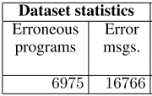
04
Experiments
Dataset
Use the training and test datasets used in [Gupta et al., 2017] for the task of correcting typographic errors. The dataset is divided into five folds for cross validation. Each fold roughly contains about 160K labeled training examples
The programs in the datasets span 93 programming problems in an introductory programming course and make use of non-trivial C language constructs. The program lengths range from 75 to 450 tokens.
test datasets
Experiment Configuration and Training
LSTM encoder: Two recurrent layers with 128 cells each
Vocabulary size: 91, embedded into 24-dimensional vectors
Except some common library functions such as printf and scanf, all other function and variable identifiers are mapped to a special token ID. Numbers to NUM and strings to STR.
32 parallel agents, and a learning rate of 0.0001 for optimizing our model using the ADAM optimizer
Max_episode_len = 100, step_penalty = −0.005, edit_penalty = −0.025, maximum_reward = 1, intermediate_reward = 0.045
Use expert demonstrations for one tenth of examples in the training dataset
DeepFix: Fixing common c language errors by deep learning (AAAI-2017)
Notes:
DeepFix has also been evaluated on some programs with seeded errors. In this work, we only use the test set of student-written erroneous programs.

Slide 13
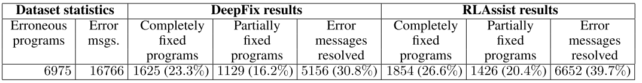
04
Experiments
Evaluation
Comparison with DeepFix
It works at a finer token-level granularity compared to the coarser line-level granularity of DeepFix
DeepFix halts when it cannot fix a line, i.e., if it fails to fix an erroneous line, it cannot fix the subsequent er- roneous lines.

Slide 14
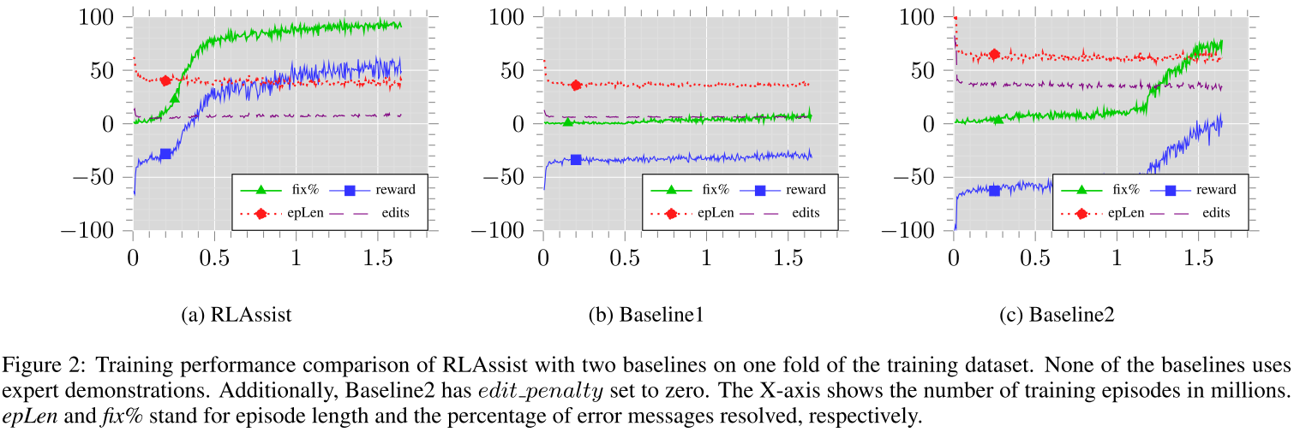
04
Experiments
Evaluation
Comparison with Baselines (do not use expert demonstrations for training)
Baseline2 matches the performance of DeepFix on the test dataset. In fact, it slightly outperforms DeepFix
RLAssist can also be trained entirely through self-exploration without using any expert demonstrations

Slide 15
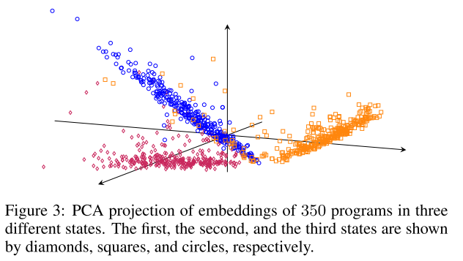
04
Experiments
Evaluation
Embedding Visualization
Select 350 test programs containing only one error per program. Next, we get embeddings corresponding to the following three states of each of these programs:
(1) when the cursor is set to the first token of the line preceding the erroneous line
(2) when the cursor is set to the first token of the erroneous line
(3) when the cursor is set to the error location and the program has been fixed.
This shows that RLAssist’s encoder learns to capture not only the syntactic validity of the programs but also the location of the errors in them.
This in turn helps the agent select appropriate actions, e.g., move_down in the first state and move_right in the second state

Slide 16
Video Demonstration

Slide 17
Thanks
Deep Reinforcement Learning for Programming Language Correction

